Slide 1
FinTech: Advanced Fish Species Identification
Project Guide :
Mrs.G.Usha Devi AHoD / AI&DS ,KRCE.
Members Name – Register Number(VII SEM AI&DS):
1. DEEPIKA B-8115U20AD008
2.RISHIKA S-8115U20AD035
3.THARSHNE K-8115U20AD044
4.VINODHINI C-8115U20AD048

Slide 2
OBJECTIVE
To accurately identify fish species based on their unique visual features.
Train the model to be robust
Enable the model to automatically extract relevant features
Accommodating increased data volumes and maintaining performance in larger datasets.

Slide 3
LITERATURE SURVEY
S.NO | YEAR | TITLE | AUTHOR | ALGORITHM | FUTUREWORK
01 | 2017 | UNDERWATER FISH SPECIES CLASSIFICATION USING CONVOLUTIONAL NEURAL NETWORK AND DEEP LEARNING | D. Rathi, S. Jain, and S. Indu | CNN Deep Learning Image Processing | The method need to achieve 100% accuracy.
02 | 2019 | UNDERWATER FISH DETECTION WITH WEAK MULTI- DOMAIN SUPERVISION | D. A. Konovalov, A. Saleh, M. Bradley, M. Sankupellay, S. Marini, M. Sheave | Computer Vision Pattern Recognition | The robustness of target detection in real scenes needs to be improved.
03 | 2020 | A REALISTIC FISH‑HABITAT DATASET TO EVALUATE ALGORITHMS FOR UNDERWATER VISUAL ANALYSIS | Alzayat Saleh,Issam H.Laradji,Dmitry.A.Konovalov,Michael Bradley, David Vazquez Marcus Sheaves | CNN-ResNet-50 Deep Learning | Consider challenges that fall under weak supervision, active learning, or few-shot learning.

Slide 4
04 | 2022 | FISH SURVEYS ON THE MOVE: ADAPTING AUTOMATED FISH DETECTION AND CLASSIFICATION FRAMEWORKS FOR VIDEOS ON A REMOTELY OPERATED VEHICLE IN SHALLOW MARINE WATERS | Rod M. Connolly, Kristin I.Jinks, Cesar Herrera, Sebastian Lopez-Marcano | R-CNN Detectron2 YOLOv5 | Analysis of imagery from mobile cameras to be included in ongoing reﬁnement of deep learning procedures
05 | 2022 | ANALYSIS OF UNDERWATER IMAGE PROCESSING METHODS FOR ANNOTATION IN DEEP LEARNING BASED FISH DETECTION | Jose-Luis, Lisani,Ana-Belen Petro,Catalina Sbert, Amaya Alvarez-Ellacuria | Image Restoration Image Enhancement Deep Learning | Improve the performance of a CNN object detector when used for pre-processing the images.
06 | 2023 | AUTOMATIC DETECTION AND CLASSIFICATION OF COASTAL MEDITERRANEAN FISH FROM UNDERWATER IMAGES: GOOD PRACTICES FOR ROBUST TRAINING | Ignacio A. Catala, Amaya A lvarez-Ellacurıa, JoseLuis, Lisani Josep Sanchez | Object detection Faster RCNN Classification YOLO | Need to improve the efficiency while working with large datasets.

Slide 5
EXISTING SYSTEM
Focus: Concentrates on freshwater fish species identification
Technology Used: Introduces the FishDeTec prototype system - the VGG16 deep Convolutional Neural Network (CNN) model.
Challenges Addressed: Doesn't explicitly mention challenges
Efficiency: VGG16 might be less efficient in terms of speed and memory usage compared to MobileNet v2.

Slide 6
PROPOSED SYSTEM
Focus: Assessing the relative abundance of fish species in various underwater environments.
Technology Used: Introduces a technology using the MobileNet v2 Architecture
Challenges Addressed: Highlights challenges in underwater imagery and minute differences between some fish species.
Efficiency: MobileNetv2 is chosen for its lightweight architecture, making it more efficient in terms of speed and memory usage compared to VGG16.

Slide 7
BLOCK DIAGRAM
DATA COLLECTION
(Collecting fish images)
DATA PREPROCESSING
(Cleaning and Splitting data)
MODEL PREPARATION
(Setup the MobileNetV2 model)
MODEL OPTIMIZATION
(Optimize for better performance)
MODEL EVALUATION
(Evaluate Model Performance)
MODEL TRAINING
(Train the model with Training Data)
MODEL DEPLOYMENT
(Deploy the model for
Real-Time Detection)
POST-DEPLOYMENT EVALUATION
MAINTENANCE AND UPDATES

Slide 8
LIST OF MODULES
Data Collection
Exploratory Analysis
Test-Train Split
Image Generation & Preprocessing
Model Training & Evaluation (MobileNet v2 Architecture)

Slide 9

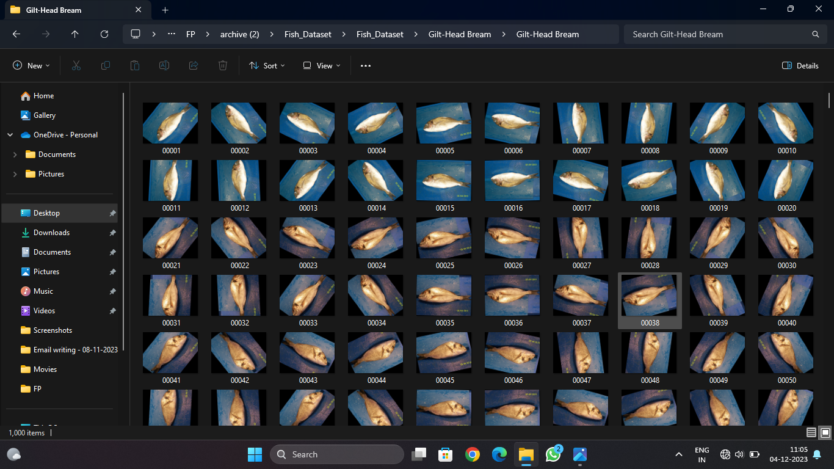
IMPLEMENTATION DATA COLLECTION

Slide 10
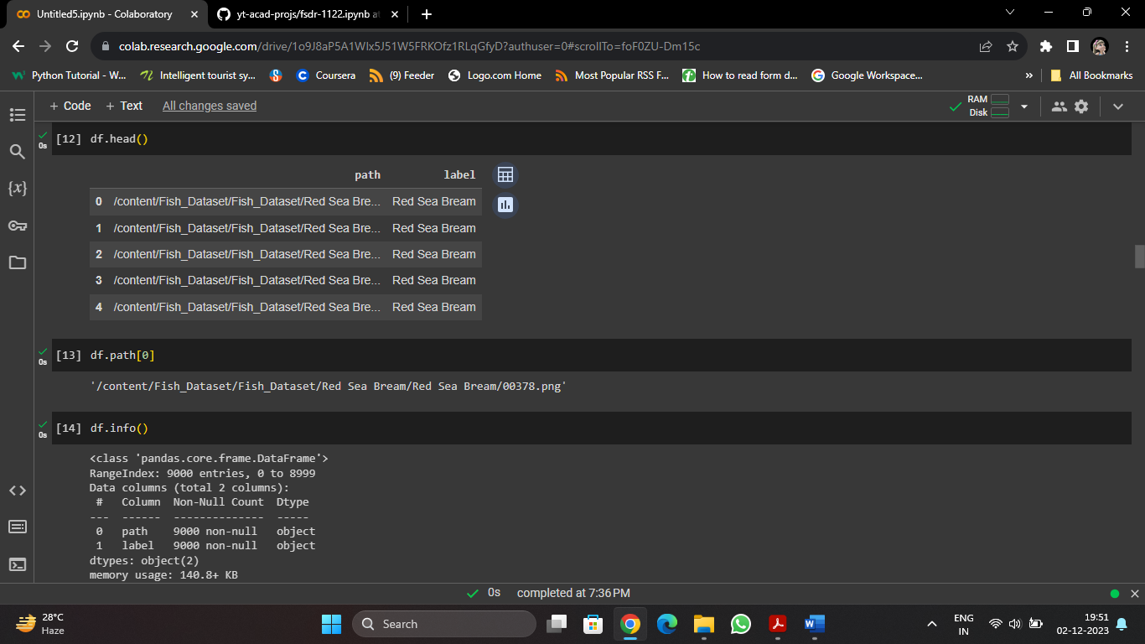

EXPLORATORY ANALYSIS

Slide 11
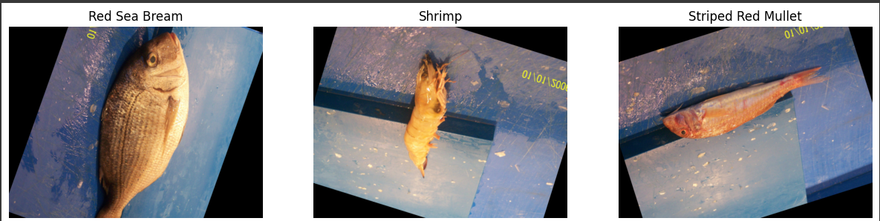
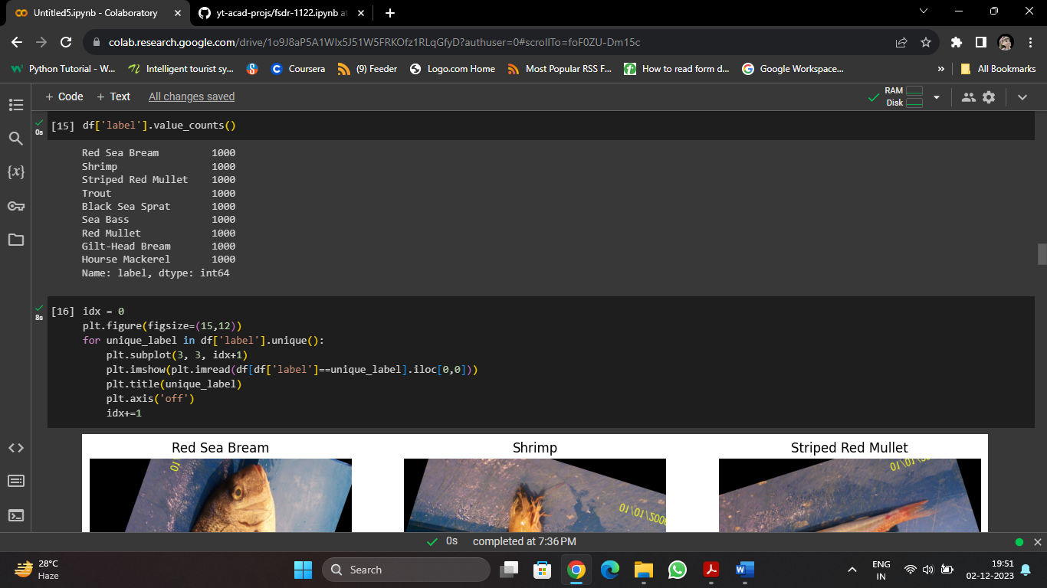
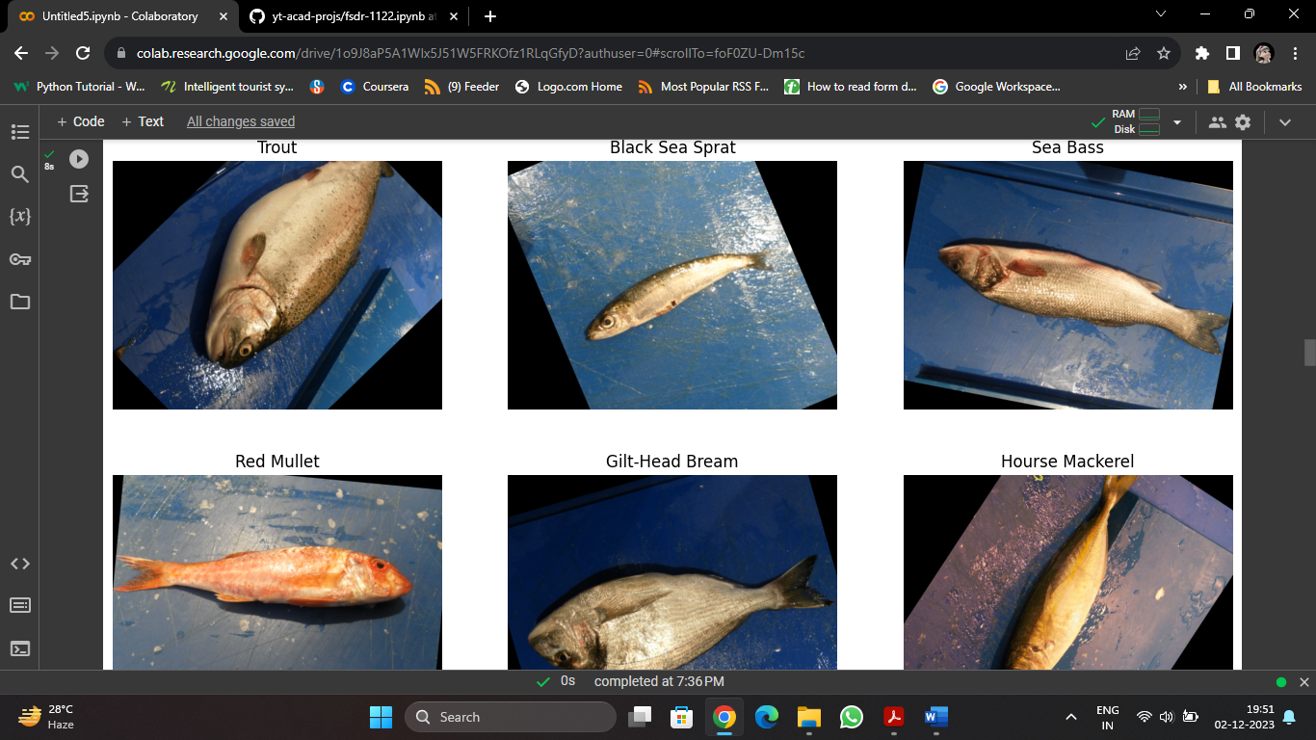
EXPLORATORY ANALYSIS

Slide 12
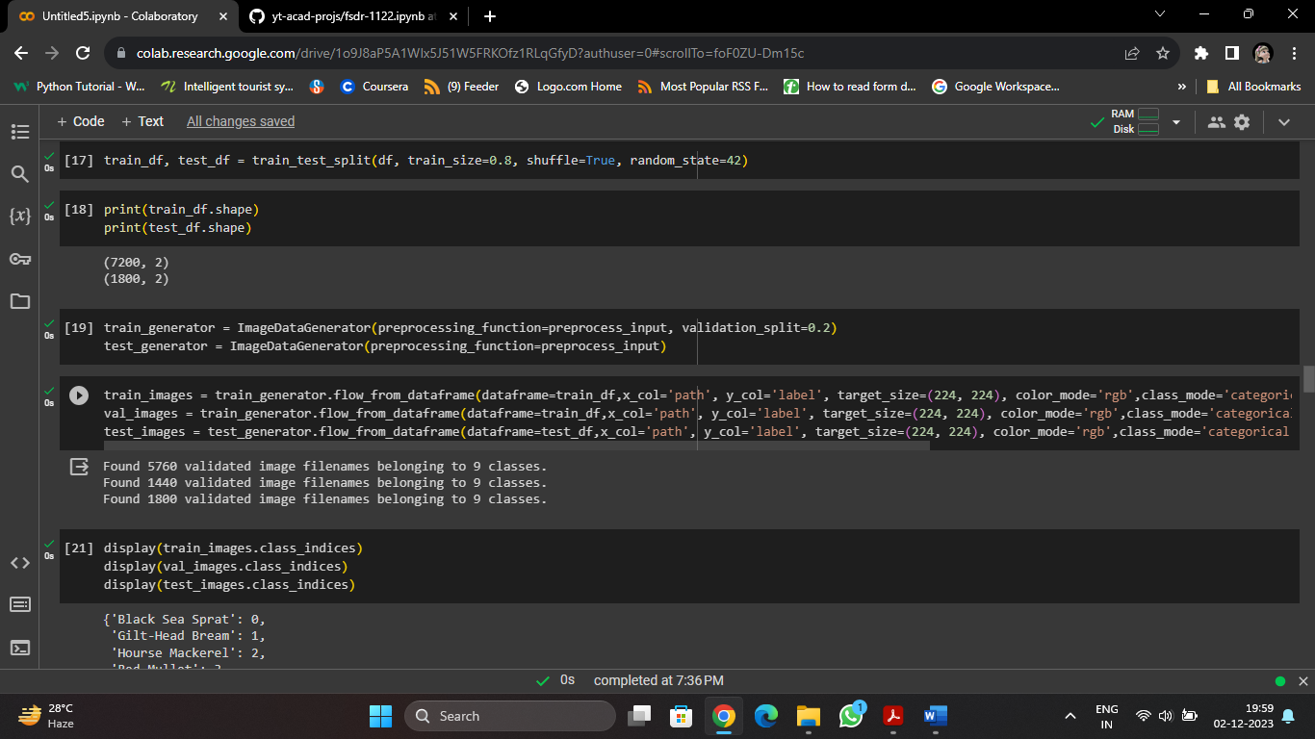
TEST-TRAIN SPLIT

Slide 13

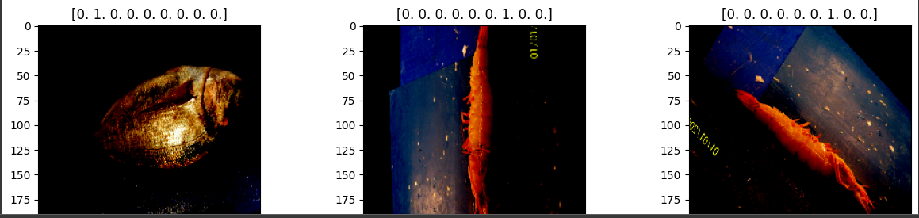
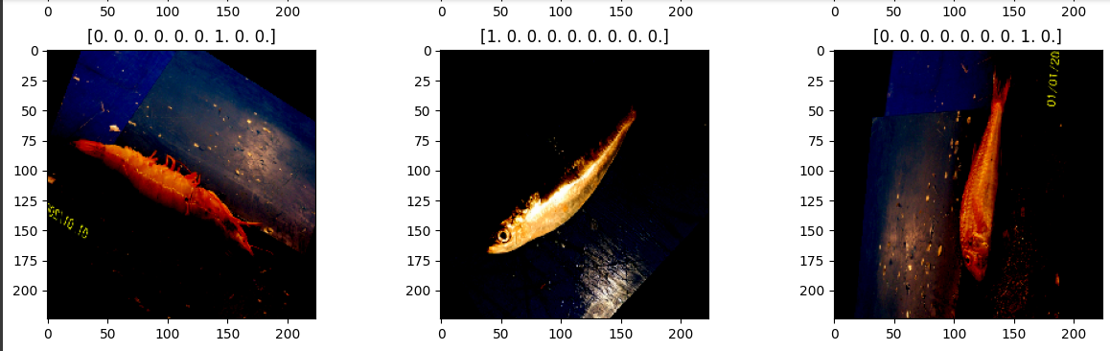
IMAGE GENERATION AND PREPROCESSING

Slide 14

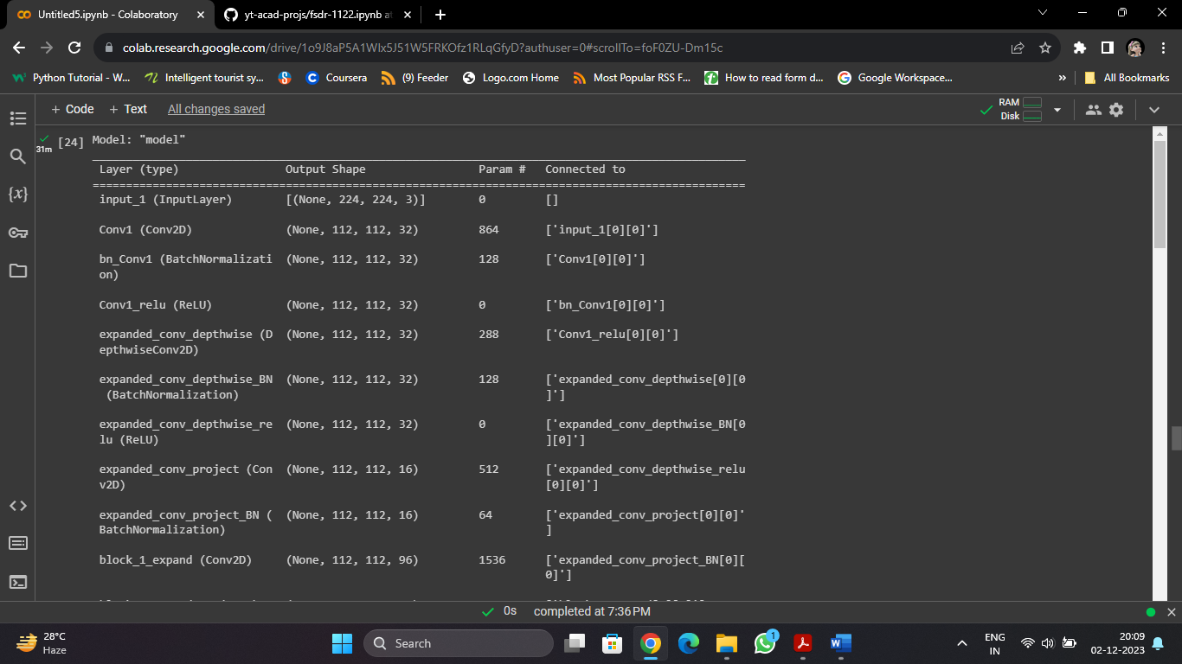
MODEL TRAINING AND EVALUATION (MobileNet V2 Architecture)

Slide 15
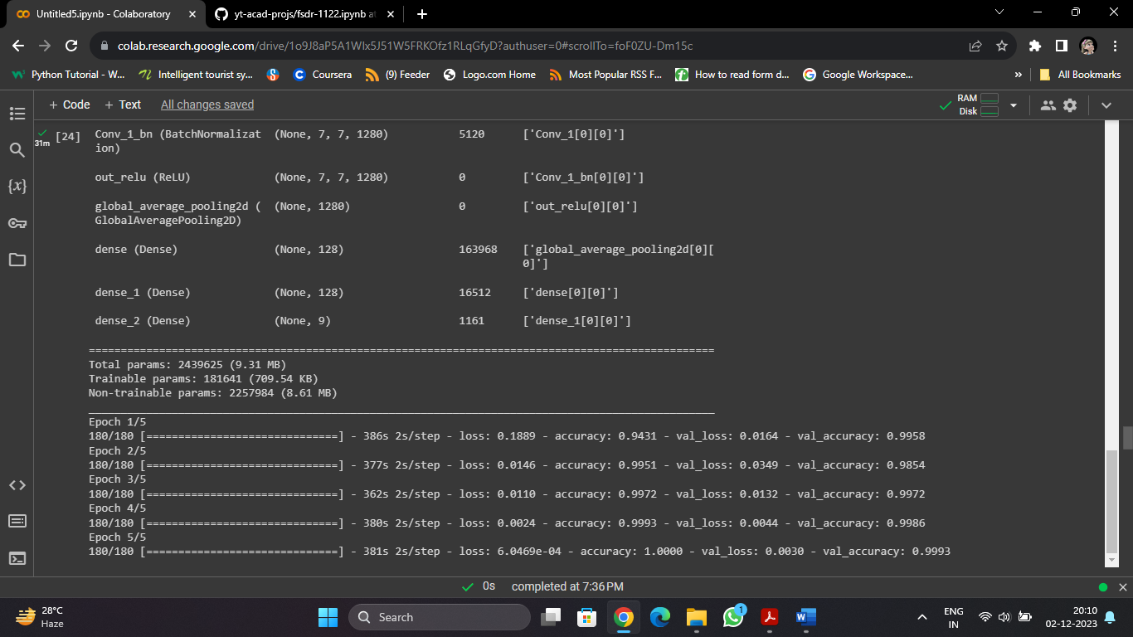
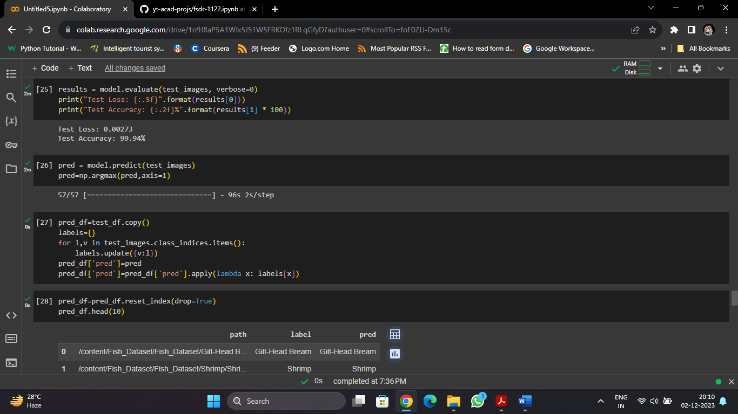
MODEL TRAINING AND EVALUATION (MobileNet V2 Architecture)

Slide 16
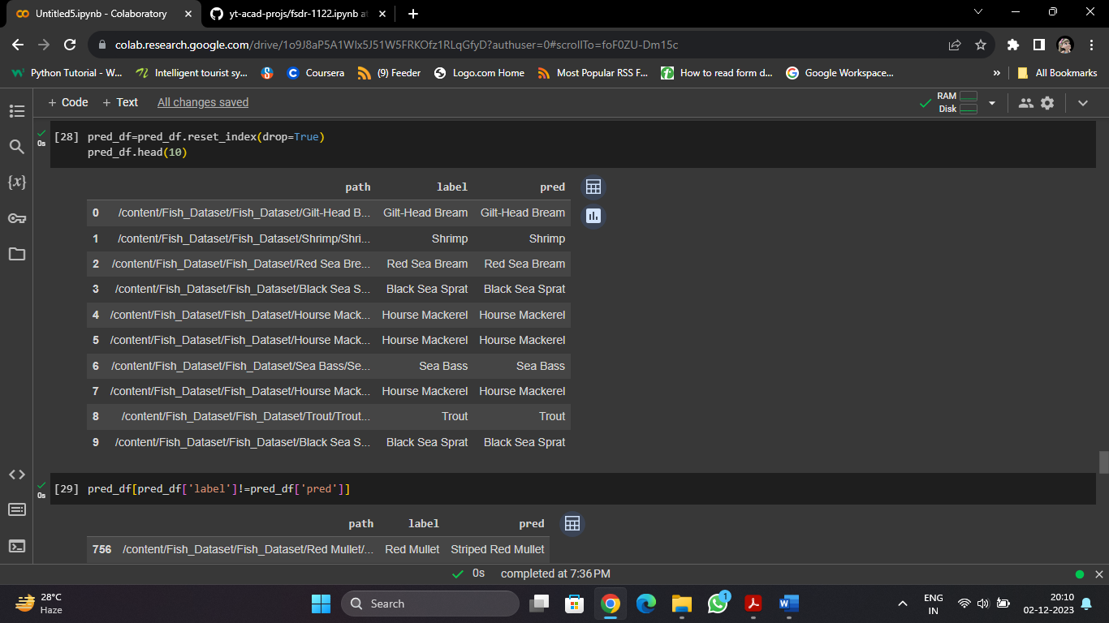
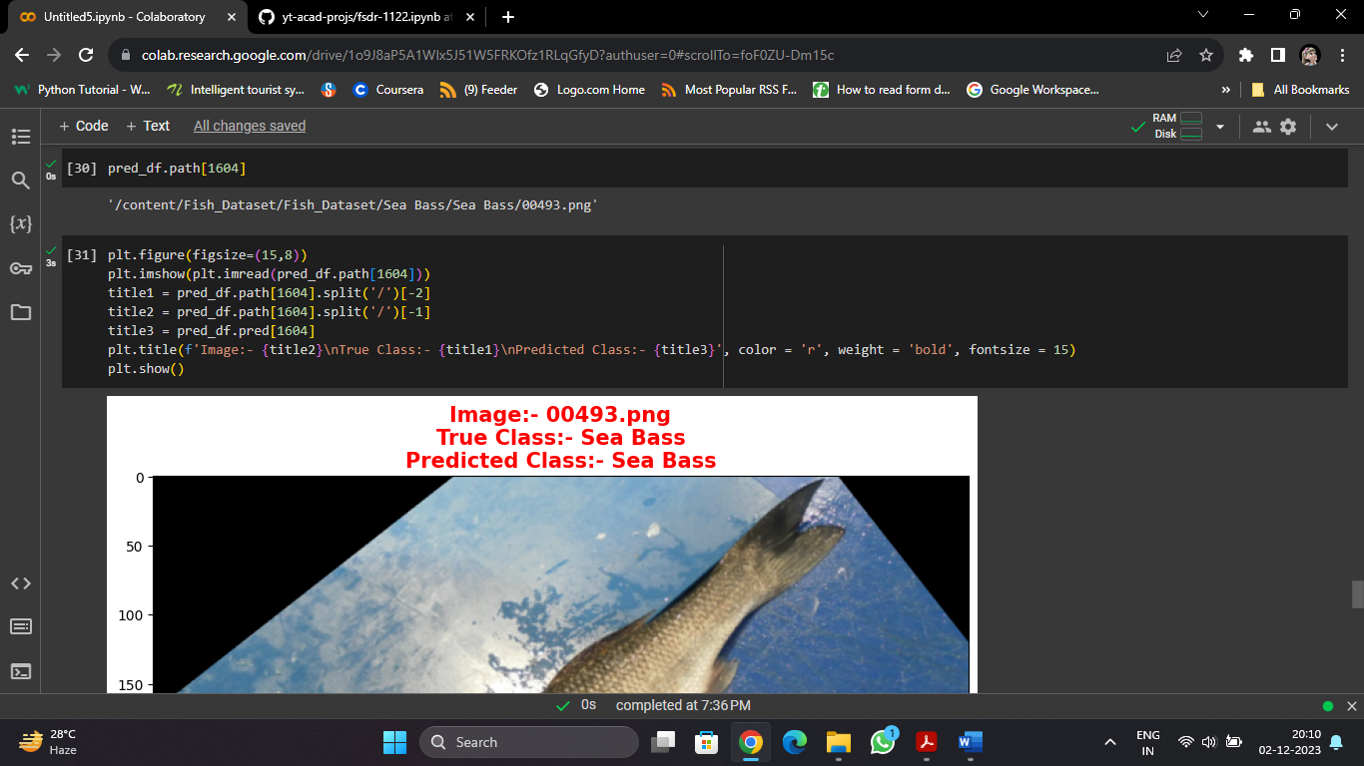
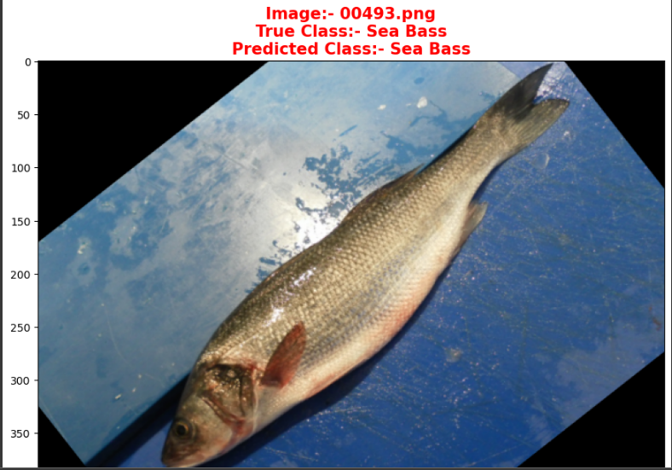
MODEL TRAINING AND EVALUATION (MobileNet V2 Architecture)

Slide 17
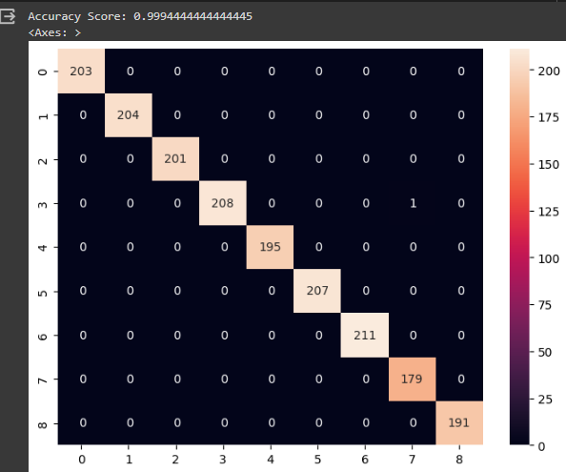

MODEL TRAINING AND EVALUATION (MobileNet V2 Architecture)

Slide 18
CONCLUSION
This project demonstrates the application of deep learning techniques for automatically detecting and classifying fish species in underwater images and videos.
It achieves high accuracy through transfer learning and provides opportunities for further exploration and experimentation.

Slide 19
FUTURE ENHANCEMENT :
Further explore on other real-world applications of deep learning, such as object detection, image segmentation, or natural language processing.
To deploy this proposed system to next level

Slide 20
Thank You…………..!

